Slide 1
FEATURE DATA
VS
HISTOGRAM
DATA SCIENCE PRACTICE

Slide 2
Data Science Flow
Let`s start!

Slide 3
1
Data Collection
CGIs, Sampling Automation
2
Data Preprocessing
Median Filter, Data cleansing
3
Feature Extraction
EM, GMM, HHT, PCA, LDA, etc.
4
Transformation
Histogram, KLD, EMD, K-Means, Kernel Mapping
Notes:
Histogram will applied on transformation phase

Slide 4
5
Modelling
T-Test, Chi-Square, Wilcoxon Signed Rank Test
6
Experiment Design
Random Sampling, Cross Validation, LOPO
Result
FAR, FRR, EER, etc.

Slide 5
Why do we use Histogram ?
Feature Data Vs. Histogram
To improve performance, histogram approach is a possible solution for feature quantification.
Chien-Cheng Lin et al, 2015
The reason is that histogram approach involves constructing authentication models by learning the distributions of features; therefore, the performance of an authentication system could be improved if it could have sufficient data to learn in training phase.
Computer Science and Information Engineering – National Central University - 1

Slide 6
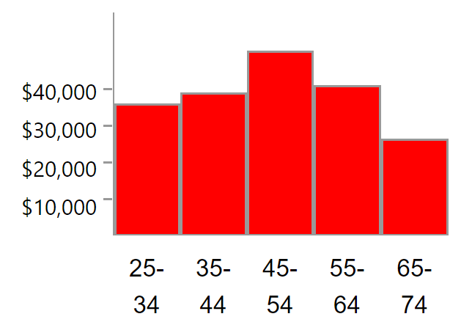
What Is Histogram?
Feature Data Vs. Histogram
A Histogram is a vertical bar chart that depicts the distribution of a set of continuous data
Histograms look very similar to bar graphs, but there is one striking factor that separates them.
The bars in bar graphs are separated by constant intervals, but the bars of histograms are always touching.
Other characteristics of histograms include that the x-axis is measured in ranges to describe different parts of the data.
The bar chart below shows average household income for the four "New" states
The histogram below shows per capita income for five age groups
Vs
The chart shows that per capita income is highest in New Jersey; lowest, in New Mexico
You can see from the chart that per capita income is greatest in the 45 to 54 age group
Computer Science and Information Engineering – National Central University - 2
Notes:
Bar chart:
X axis shows the States name
Y axis shows the average income
But on Histogram chart:
X axis shows the range of age group
Y axis shows the average income

Slide 7
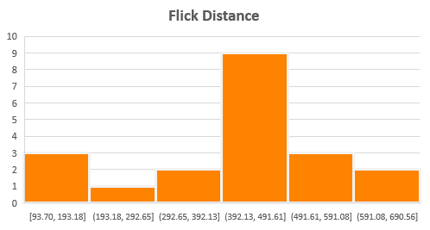
When are Histograms Used?
Feature Data Vs. Histogram
1
Summarize large data sets graphically
Make it much easier to understand by organizing large data into a Histogram.
Feature Data : Flick Distance
1 person, 20 flicks
439.72 | 453.85 | 463.40 | 566.57
337.10 | 556.90 | 409.33 | 403.23
541.75 | 450.32 | 154.23 | 245.34
93.70 | 418.75 | 446.87 | 109.10
444.62 | 690.56 | 592.91 | 292.73
Computer Science and Information Engineering – National Central University - 3
Notes:
Left Figure shows raw data of Flick distance of one user. Histogram can simplify the large data by organizing each value to the range

Slide 8
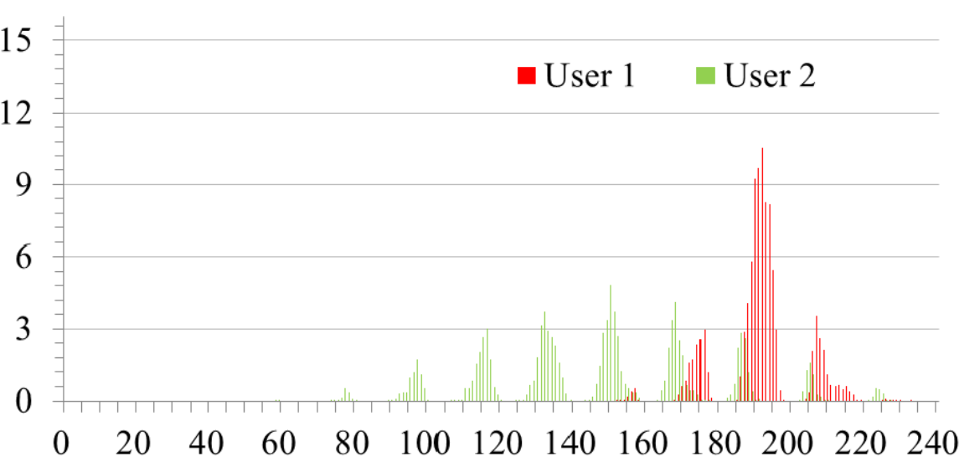
When are Histograms Used?
Feature Data Vs. Histogram
2
Compare data distributions
Easily virtualize the differences between two or more large data distributions
Histogram of the touch-position for two different users
Computer Science and Information Engineering – National Central University - 4
Notes:
You can use histogram to visualize two or more large data distribution.
For example, Red histogram represent data distribution of User 1 and Green represent data distribution of user B.
From this histogram you can easily distinguish behavior of two different user.

Slide 9
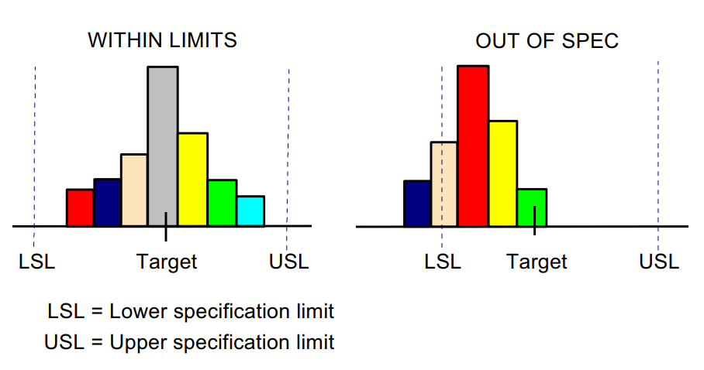
When are Histograms Used?
Feature Data Vs. Histogram
3
Compare process results with specification limits
If you add the process specification limits to your Histogram, you can determine quickly whether the current process was able to produce good products
Computer Science and Information Engineering – National Central University - 5
Notes:
Visualize the histogram and add specification limits, you can easily determine which data distribution that meet the specification and which data that out of spesification

Slide 10
When are Histograms Used?
Feature Data Vs. Histogram
4
Tool to assist in decision making
As you will see as we move along through this module, certain shapes, sizes, and the spread of data have meanings that can help you in investigating problems and making decisions
Distance Formula
 Euclidean Dist.
 KL Divergence
 Earth Mover Dist.
Computer Science and Information Engineering – National Central University - 6
Notes:
Rather than calculate classification with large feature data, we can transform the feature data to histogram and than do the classification. It will decrease computation cost.
For example,
Suppose we have training data like this, and we have testing data like this, so which testing data that have most similarity to training data.
We can calculate the similarity with distance measurement formula like Euclidean dist, KL div, and EMD. Further explanation of each distance formula will be explained by robi in next session

Slide 11
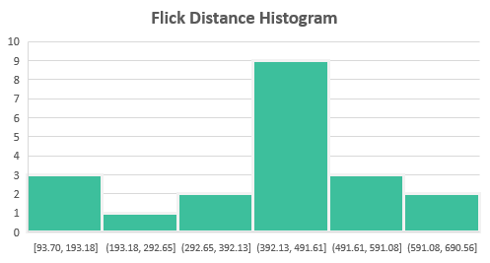
Part of Histogram
Feature Data Vs. Histogram
Title
The title briefly describes the information that is contained in the Histogram
Frequency
The vertical or Y-axis is the scale that shows you the number of times the values within an interval occurred
Bin
Bins have two important characteristics, height and width. The height represents the number of times the values within an interval occurred. The width represents the length of the interval covered by the bin
The horizontal or X-axis shows you the scale of values into which the measurements fit. These measurements are generally grouped into intervals to help you summarize large data sets
Bin Size / Interval
Computer Science and Information Engineering – National Central University - 7

Slide 12
Pattern Of Histograms
Feature Data Vs. Histogram
Symmetric
Skewed Right
Skewed Left
have one clear center that much of the data clusters around
The data is generally clustered around a small value and as you look for larger and larger values, there are fewer and fewer
As you move to smaller numbers, there is less and less frequency. This means there are fewer and fewer observations
Bimodal
Multimodal
Uniform
Instead of one clear center where there is are a lot of observations, there are two. Often this means that you are looking at two different groups and should take a closer look to see if you can separate them
A probability distribution with more than one peak, or “mode.”
Every bar is almost exactly the same height
Computer Science and Information Engineering – National Central University - 8
Notes:
This is the variation of histogram pattern. You can use histogram pattern to analyze characteristic of your data distribution

Slide 13
Constructing Histogram
Feature Data Vs. Histogram
Number of Bin and Bin Size
There is no "best" number of bins, and different bin sizes can reveal different features of the data
Feature
Data
Flick | Touch Pressure
1 | 0.29804
1 | 0.32549
1 | 0.32157
2 | 0.29804
2 | 0.31765
2 | 0.31765
3 | 0.29804
3 | 0.31373
3 | 0.31765
3 | 0.32157
3 | 0.32157
3 | 0.32549
3 | 0.32549
3 | 0.32549
3 | 0.32549
3 | 0.32941
3 | 0.32549
3 | 0.32941
3 | 0.32549
3 | 0.32157
4 | 0.31765
4 | 0.31765
4 | 0.32549
4 | 0.32157
5 | 0.29804
5 | 0.32157
5 | 0.32941
Num of Bin | Interval Bin Size = 0.005 | Count
1 | 0.29000-0.29500 | 0
2 | 0.29500-0.30000 | 4
3 | 0.30000-0.30500 | 0
4 | 0.30500-0.31000 | 0
5 | 0.31000-0.31500 | 1
6 | 0.31500-0.32000 | 5
7 | 0.32000-0.32500 | 6
8 | 0.32500-0.33000 | 11
9 | 0.33000-0.33500 | 0
Total |  | 27
Summarize
Histogram
Computer Science and Information Engineering – National Central University - 9
Notes:
Summarize each data into bin. In this case 1 bin will consist data in range of 0.005. we can call it bin size. Bin size will determine the interval in one bin.
We put each data to the each bin. You can summarize the data by tally method.
After you summarize the data, draw the histogram based on each bin count.

Slide 14
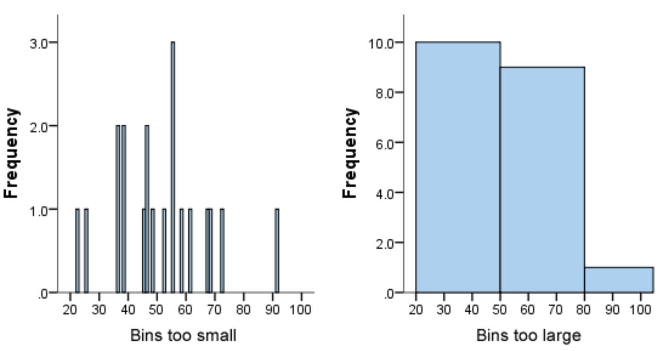
Choosing the Correct Bin Size
Feature Data Vs. Histogram
Using narrower bins will show too much individual data and does not allow the underlying pattern (frequency distribution) of the data to be easily seen.
At the other hand, if we use wider bins we will unable to find the underlying trend in the data.
Computer Science and Information Engineering – National Central University - 10
Notes:
But the question is, how we determine the correct bin size in your histogram.
The answer is no "best" number of bins, and different bin sizes can reveal different features of the data.

Slide 15
Constructing Histogram (Probability Value)
Feature Data Vs. Histogram
Feature
Data
Flick | Touch Pressure
1 | 0.29804
1 | 0.32549
1 | 0.32157
2 | 0.29804
2 | 0.31765
2 | 0.31765
3 | 0.29804
3 | 0.31373
3 | 0.31765
3 | 0.32157
3 | 0.32157
3 | 0.32549
3 | 0.32549
3 | 0.32549
3 | 0.32549
3 | 0.32941
3 | 0.32549
3 | 0.32941
3 | 0.32549
3 | 0.32157
4 | 0.31765
4 | 0.31765
4 | 0.32549
4 | 0.32157
5 | 0.29804
5 | 0.32157
5 | 0.32941
Num
of Bin
Interval
Count
Probability
Bin Size = 0.005
Summarize
1
0.29000
-
0.29500
0
0/27 = 0
2
0.29500
-
0.30000
4
4/27 = 0.148
3
0.30000
-
0.30500
0
0
4
0.30500
-
0.31000
0
0
5
0.31000
-
0.31500
1
0.037
Histogram
6
0.31500
-
0.32000
5
0.185
7
0.32000
-
0.32500
6
0.454
8
0.32500
-
0.33000
11
0.407
9
0.33000
-
0.33500
0
0
Total
27
Computer Science and Information Engineering – National Central University - 9
Notes:
Summarize each data into bin. In this case 1 bin will consist data in range of 0.005. we can call it bin size. Bin size will determine the interval in one bin.
We put each data to the each bin. You can summarize the data by tally method.
After you summarize the data, draw the histogram based on each bin count.

Slide 16
Handling Noise
Feature Data Vs. Histogram
Training Data
Testing Data
Person A
Person A
Noise
Behavior Change
Signal Problem
Sensor Problem
Training Data
Testing Data
Person A
Person A
Adjustment
Spreading the value of histogram to neighbor’s bin
Shorter
Computer Science and Information Engineering – National Central University - 11
Notes:
We want the distance between training and testing data on same person will shorter rather than we use original histogram.

Slide 17

Handling Noise
Feature Data Vs. Histogram
Training Data
Without Adjustment
Person A
1 | 2 | 3 | 4 | 5 | 6 | 7 | 8 | 9
0 | 0.002 | 0.065 | 0.24 | 0.367 | 0.256 | 0.064 | 0.006 | 0
-
-
-
-
-
-
-
-
-
1 | 2 | 3 | 4 | 5 | 6 | 7 | 8 | 9
0 | 0 | 0.002 | 0.065 | 0.24 | 0.367 | 0.256 | 0.064 | 0.006
+
Testing Data
Person A
$$\sqrt{0.1033}=\text{0.3214}$$
Computer Science and Information Engineering – National Central University - 12

Slide 18

Handling Noise
Feature Data Vs. Histogram
with Adjustment
Training Data
without Adjustment
Person A
1 | 2 | 3 | 4 | 5 | 6 | 7 | 8 | 9
0.0005 | 0.0173 | 0.093 | 0.228 | 0.3075 | 0.2357 | 0.0975 | 0.019 | 0.0015
1 | 2 | 3 | 4 | 5 | 6 | 7 | 8 | 9
0 | 0.002 | 0.065 | 0.24 | 0.367 | 0.256 | 0.064 | 0.006 | 0
-
-
-
-
-
-
-
-
-
-
-
-
-
-
-
-
-
-
1 | 2 | 3 | 4 | 5 | 6 | 7 | 8 | 9
0 | 0.0005 | 0.0173 | 0.0931 | 0.2283 | 0.308 | 0.2361 | 0.0976 | 0.019
Testing Data
1 | 2 | 3 | 4 | 5 | 6 | 7 | 8 | 9
0 | 0 | 0.002 | 0.065 | 0.24 | 0.367 | 0.256 | 0.064 | 0.006
Person A
+
+
$$\sqrt{0.0614}=\text{0.2478}$$
$$\sqrt{0.1033}=\text{0.3214}$$
Shorter Distance
Computer Science and Information Engineering – National Central University - 13

Slide 19
Histogram Adjustment
Feature Data Vs. Histogram
Num of Bin | 1 | 2 | 3 | 4 | 5 | 6 | 7 | 8 | 9
Count | 0 | 2 | 65 | 240 | 367 | 256 | 64 | 6 | 0
UpTemp
Count | 1 | 32.5 | 120 | 183.5 | 128 | 32 | 3 | 0
DownTemp
DownTemp
Count | 0 | 1 | 32.5 | 120 | 183.5 | 128 | 32 | 3
UpTemp
Calculate Uptemp
Calculate DownTemp
Merge Histogram
1
Select 2nd bin from original hist. until the upper bin
Divide the frequency in each bin by 2
2
Select 1st bin from original hist. until the upper bin - 1
Divide the frequency in each bin by 2
3
Shift UpTime bin to the left from the original hist.
Shift DownTemp bins to the right from the original hist.
1 | 2 | 3 | 4 | 5 | 6 | 7 | 8 | 9
0 | 2 | 65 | 240 | 367 | 256 | 64 | 6 | 0
+
1 | 2 | 3 | 4 | 5 | 6 | 7 | 8
1 | 32.5 | 120 | 183.5 | 128 | 32 | 3 | 0
+
1 | 2 | 3 | 4 | 5 | 6 | 7 | 8
0 | 1 | 32.5 | 120 | 183.5 | 128 | 32 | 3
=
1 | 2 | 3 | 4 | 5 | 6 | 7 | 8 | 9
1 | 34.5 | 186 | 456 | 615 | 471.5 | 195 | 38 | 3
Computer Science and Information Engineering – National Central University - 14

Slide 20
Histogram Normalization
Feature Data Vs. Histogram
1
Calculate probability value
Original Histogram
New Histogram
Divide each bin by how many data in temporary histogram
Num of Bin | 1 | 2 | 3 | 4 | 5 | 6 | 7 | 8 | 9
Count | 0 | 2 | 65 | 240 | 367 | 256 | 64 | 6 | 0
Num of Bin | 1 | 2 | 3 | 4 | 5 | 6 | 7 | 8 | 9
Count | 5E-04 | 0.017 | 0.093 | 0.228 | 0.308 | 0.236 | 0.098 | 0.019 | 0.002
1 | 2 | 3 | 4 | 5 | 6 | 7 | 8 | 9
1 | 34.5 | 186 | 456 | 615 | 471.5 | 195 | 38 | 3
temp. / 2000
1 | 2 | 3 | 4 | 5 | 6 | 7 | 8 | 9
5E-04 | 0.017 | 0.093 | 0.228 | 0.308 | 0.236 | 0.098 | 0.019 | 0.002
Computer Science and Information Engineering – National Central University - 15

Slide 21
Handling Noise
Feature Data Vs. Histogram
Does our adjustment method will make our system
more noise-tolerant?
We will explore it in LAB session
Computer Science and Information Engineering – National Central University - 13

Slide 22
THANK YOU

